Slide 1


SDP
LECTURE
The Abstract Factory Pattern
Software Design Patterns
Diploma in IT
Year 2 (2024/25), Semester 4
6.2
Notes:
Hi everyone! So we just covered the Factory Method design pattern, which encapsulates object creation code into a method that you can override to create the concrete products that you want. We will now look at another creational pattern called the Abstract Factory design pattern that does object creation in another way.

Slide 2
Very Dependent PizzaStore Class
public class DependentPizzaStore {
public Pizza createPizza(string style, string type)
{
if (style == “NY”)
if (type == “cheese”)
return new NYStyleCheesePizza();
else if (type == “hawaiian”)
return new NYStyleHawaiianPizza();
...
else if (style == “Chicago”)
if (type == “cheese”)
return new ChicagoStyleCheesePizza();
...
}
}
Notes:
But before we dive into the Abstract Factory pattern, let’s take a step back to introduce another design principle. Remember the PizzaHot example, where we have different versions of different types of pizza depending on the region? We handled that with the factory method pattern in the last lesson, right? Now, let’s pretend that we don’t know about that pattern, how would we code a PizzaStore in a very straightforward manner? Quite likely we will just use a bunch of nested if-else statements, like || this. We still create a PizzaStore class with a createPizza method, and we might put in 2 parameters, one to specify the style of pizza and the other to specify the type. Then we just use if-else statements, so this block of code handles all the New York style pizzas by returning the appropriate pizza class. But we also know that this code will be a nightmare to maintain.

Slide 3
Object Dependencies
PizzaStore
ChicagoStyleCheesePizza
NYStyleHawaiianPizza
NYStyleCheesePizza
ChicagoStyleHawaiianPizza
ChicagoStylePepperoniPizza
NYStylePepperoniPizza
Notes:
One of the main issues with this code is all the dependencies that PizzaStore has on all the different classes of Pizza. What do I mean by dependency? Basically, whenever your code instantiates a concrete class, that code is dependent on the class, so if any of those classes change, that code may also have to change. This diagram represents dependency with an arrow, and you can see that PizzaStore is dependent on a lot of Pizza classes. If you look at this as a tree, we say that PizzaStore is a higher level component, while the different pizzas are lower level components.

Slide 4
Let’s Apply a Design Principle
Principle: “Dependency Inversion Principle”
High-level modules should not depend on low-level modules; both should depend on abstractions
A “high-level” module is a class with behaviour defined in terms of other “low-level” modules
PizzaStore is defined in terms of Pizzas
We should not depend on concrete classes, we should use abstractions instead.
Notes:
It should be pretty clear that reducing dependencies to concrete classes is a good thing. In fact, there is an OO design principle that formalizes this idea, which is || called the Dependency Inversion Principle. This principle states that high-levels modules should not depend on low-level ones; instead, both should depend on abstractions. Like we saw in the previous slide, a || “high-level” module is a class that has its behaviour defined in terms of other, “low-level” modules, like how our very dependent PizzaStore class was defined in terms of the various concrete implementations of Pizzas. This principle says that || high-level modules should not depend on low-level concrete class, but both should rely on abstractions instead.

Slide 5
Using Factory Method
PizzaStore
Pizza
ChicagoStyleCheesePizza
NYStyleHawaiianPizza
NYStyleCheesePizza
ChicagoStyleHawaiianPizza
ChicagoStylePepperoniPizza
NYStylePepperoniPizza
Notes:
One way we can follow the Dependency Inversion Principle is to create an abstract base Pizza class and have all our concrete pizza classes inherit from it. Once we do that, we see that our high-level PizzaStore class || now only depends on the abstraction, so it will work regardless of what actual pizza is passed into it. At the same time, we see that all our low-level specific pizzas also depend on the abstraction since they must all implement this abstract class. Just like that, both our high and low-level modules depend on an abstraction, as recommended by the Dependency Inversion Principle.

Slide 6
Dependency Inversion
We “invert” our thinking
Previously, higher-level modules depend on lower-level modules
Our PizzaStore class depended on all the different types of Pizza
Now, all modules depend on abstractions
Both PizzaStore and different types of Pizza depend on the Pizza abstract class
Notes:
So what does the word “inversion” mean in the Dependency Inversion Principle? To be fair, the word isn’t 100% accurate. The principle is named this way because it suggests that we || invert our usual thinking. Before this principle was well understood, it is quite natural to have || designs where high-level components depend on low-level ones, such as having a PizzaStore class depend on all the different types of pizza that it is selling. But as we now know, doing that results in tight coupling between lots of classes, which is a potential maintenance nightmare. We should instead invert our thinking so that high-level modules no longer depend on low-level modules. The reason I say that the word isn’t 100% accurate is because an actual inversion would mean that low-level modules will depend on high-level ones, but that isn’t a good idea either. So remember, this principle tells us that all modules should depend on || abstractions instead, which is why both the PizzaStore class and all the different specific Pizza classes should depend on an abstract Pizza class. This way, we minimize coupling and reduce the number of unnecessary dependencies.

Slide 7
Design Guidelines for DIP
No variable should hold a reference to a concrete class
Avoid using “new”
No class should derive from a concrete class
Derive from an abstraction (abstract class or interface) instead
No method should override an implemented method of any base class
Implemented methods should be inherited by all subclasses
Notes:
In order to properly follow the Dependency Inversion Principle, we can follow three guidelines. Firstly, || no variable should hold a reference to a concrete class. Every time you use “new” to create a concrete class object and assign it to a variable, you are creating a dependency. You can get around this by using a factory. Secondly, || no class should derive from a concrete class, because if you derive from a concrete class, you are now dependent on a concrete class. Therefore, you should derive from either an abstract class or an interface instead. Lastly, you should || not override an implemented method of a base class. The idea is that if the base class has an implemented method, it is meant to be inherited by all subclasses, so if any subclass has to override it, then that subclass doesn’t really have an is-a relationship with the base class.
This sounds good, except that if you follow these guidelines strictly, you will never be able to write a single program because you will violate at least one of them every time you instantiate a class. These are guidelines you should strive for, not strict rules you must follow. Just bear these in mind and make sure that you have a good reason to violate them. For example, having a dependency is only an issue if the class you are depending on may change. If you are very sure that a concrete class will never change, then there is no issue with having a reference to an instance of it.

Slide 8
New Requirement for PizzaHot
In our current design, ingredients like dough, sauce and toppings are represented by strings in the Pizza class
New requirement: PizzaHot wants to store information on their high-quality ingredients
Represent these ingredients as classes instead
Notes:
With that out of the way, let us get back to our PizzaHot scenario, and as usual, the bosses have come up with a new requirement. If you recall, our Pizza class has attributes like dough, sauce and toppings that represent different types of ingredients for different pizzas, and in our current design, all of these ingredients are represented by strings. Now, the management of PizzaHot is proud of their high quality ingredients and want to || store more in-depth information on them, so just using strings to represent them is no longer enough. Instead, these ingredients should be separate classes instead.

Slide 9
Recall: Pizza Abstract Class
public abstract class Pizza {
protected string name;
protected string dough;
protected string sauce;
protected List<string> toppings =
new List<string>();
public virtual void prepare() {
Console.WriteLine($"Preparing {name}");
Console.WriteLine($"Tossing dough: {dough}");
Console.WriteLine($"Adding sauce: {sauce}");
Console.WriteLine("Adding toppings:");
foreach (string topping in toppings)
Console.WriteLine($" - {topping}");
}
We want to replace string with classes
We make prepare() abstract
Notes:
This is the top of our current Pizza abstract class. Right now, all the ingredients are || represented by strings, but now we want to || replace them with separate classes. While we’re at it, we are also going to make || the prepare() method abstract so that each concrete Pizza subclass will define their own preparation method, and this prepare() method is where we are going to collect the individual ingredients for our pizzas.

Slide 10
Revised Pizza Class
public abstract class Pizza {
protected string name;
protected Dough dough;
protected Sauce sauce;
protected List<Topping> toppings =
new List<Topping>();
public abstract void prepare();
// Other methods, like bake(), cut(), box()
...
}
Notes:
Our new class looks like this. Both || dough and sauce are now classes instead of strings, and these are actually abstract base classes for different types of dough and sauce subclasses. Similarly, we have a || list of Toppings, and Topping is a base class for anything that qualifies as a topping, such as cheese, pepperoni or beef. Finally, we have now made the || prepare() method abstract, so our Pizza subclasses have to define their own versions. All the other methods like bake(), cut() and box() remain unchanged.

Slide 11
Ingredient Factories
Create a factory for each region to create ingredients
Define an interface for all ingredient factories
public interface PizzaIngredientFactory {
public Dough createDough();
public Sauce createSauce();
public Cheese createCheese();
...
}
Notes:
OK, so how do we create all of these different ingredient objects? What we do is create a factory class, and each regional shop will have their own type of factory that creates ingredients from the region. To do so, we define an interface for all ingredient factories, like || this. This interface contains declarations for methods that create all the region-specific ingredients, such as dough, sauce or cheese. If, for example, New York and Chicago pizzas use different types of onions, we would have a createOnion() method as well.

Slide 12
New York Ingredient Factory
Customize each method to the region
public class NYPizzaIngredientFactory: IngredientFactory {
public Dough createDough() {
return new ThinCrustDough();
}
public Sauce createSauce() {
return new MarinaraSauce();
}
public Cheese createCheese() {
return new ReggianoCheese();
}
...
}
Notes:
The next step is to create the different ingredient factories to return the correct type of ingredients. Here is our NYPizzaingredientFactory, which || implements the IngredientFactory interface. Since New York style pizzas have thin crust, marinara sauce and Reggiano cheese, our NYPizzaIngredientFactory returns those types of dough, sauce and cheese. Our ChicagoIngredientFactory would instead return thick crust dough, tomato plum sauce and mozzarella cheese since that’s what Chicago style pizzas use.

Slide 13
Let’s Make a Pizza
Meat Lover’s Pizza
All pizzas use regional dough and sauce
Toppings are regional cheese, beef and pepperoni
Beef and pepperoni are the same everywhere
public class MeatLoversPizza: Pizza {
private PizzaIngredientFactory ingredientFactory;
public MeatLoversPizza(PizzaIngredientFactory pif) {
this.ingredientFactory = pif;
}
Notes:
Now that we have set up all the pizza factories, it’s time to finally make a pizza. Let’s make a new type of pizza called a Meat Lover’s Pizza, which has cheese, beef and pepperoni as toppings. We are going to use the dough, sauce and cheese of the specific region, but let’s assume that beef and pepperoni does not differ by region and are the same everywhere. To start, we || declare our MeatLoversPizza class that inherits from the Pizza abstract base class. Next, we are going to give it a || reference to a PizzaIngredientFactory so that the pizza knows where to get its ingredients, and we will initialize this factory using the argument of the constructor.

Slide 14
Let’s Make a Pizza
public override void prepare() {
Console.WriteLine($"Preparing {name}");
dough = ingredientFactory.createDough();
Console.WriteLine($"Tossing dough: {dough.Name}");
sauce = ingredientFactory.createSauce();
Console.WriteLine($"Adding sauce: {sauce.Name}");
toppings.Add(ingredientFactory.createCheese());
toppings.Add(new Beef());
toppings.Add(new Pepperoni());
Console.WriteLine("Adding toppings:");
foreach (Topping topping in toppings)
Console.WriteLine($" - {topping.Name}");
}
}
Notes:
Preparing the Meat Lover’s Pizza is done in the prepare() method. Now that prepare() is an abstract method in the Pizza base class, we must || override it. Then we will go through the process of preparing the pizza by grabbing all the ingredients from our factory. For the dough and sauce, we will get them from calling the || createDough() and createSauce() methods in our ingredientFactory, respectively, since these are specific to the region. Next, let’s handle the toppings. Since the cheese is region-specific, we || get it from our factory. But since beef and pepperoni are the same everywhere, we can just || create it here without going through our factory. Note that the Cheese base class, the Beef class and the Pepperoni class all inherit from the Topping base class so that we can put it in our Toppings list.

Slide 15
Regional PizzaStore Subclasses
Use the ingredient factory in the regional PizzaStore
public class NYStylePizzaStore: PizzaStore {
public override Pizza createPizza(string type) {
PizzaIngredientFactory fac =
new NYPizzaIngredientFactory();
if (type == "meatlovers") {
Pizza pizza = new MeatLoversPizza(fac);
pizza.Name = “New York Style Meat Lovers
Pizza”;
return pizza;
}
else if (type == “cheese”) { ... }
}
}
Notes:
Now, let’s see how we go about actually ordering a pizza from a store. || Here is our New York style pizza store with its parameterized createPizza() method. Since this is a New York store, we || instantiate a NYPizzaIngredientFactory for it to use while creating pizzas. If we now want a Meat Lover’s Pizza, we will create a New York style version by || passing in the factory as the argument for the constructor of MeatLoversPizza. At this stage, we can also give the || pizza a proper name, so this is a nice yummy New York Style Meat Lovers Pizza. We can do the same thing for other pizzas like cheese or Hawaiian.

Slide 16
Program Flow
PizzaStore nyStore = new NYStylePizzaStore();
nyStore.orderPizza(“meatlovers”);
In createPizza():
Pizza pizza = new MeatLoversPizza(nyIngredientFactory);
pizza.Name = “New York Style Meat Lovers Pizza”;
In MeatLoversPizza prepare():
dough = ingredientFactory.createDough();
sauce = ingredientFactory.createSauce();
toppings.Add(ingredientFactory.createCheese());
toppings.Add(new Beef());
toppings.Add(new Pepperoni());
Notes:
Finally, this is how use our system. We || create a new New York style pizza store and order a Meat Lover’s Pizza from it. The orderPizza() method will call || createPizza(), which creates the proper types of pizza using the regional factory. Then, orderPizza() will prepare the pizza by calling the pizza’s || prepare() method, which will use the NYIngredientFactory to create regional-specific ingredients such as the dough, sauce and cheese, but generic ingredients like beef and pepperoni don’t have to use the factory.

Slide 17
Let’s Test It
PizzaStore nyStore = new NYStylePizzaStore();
nyStore.orderPizza(“meatlovers”);
Preparing New York Style Meat Lovers Pizza
Tossing dough: Thin Crust Dough
Adding sauce: Marinara Sauce
Adding toppings:
- Reggiano Cheese
- Beef
- Pepperoni
Baking the pizza in an oven.
Cutting the pizza into triangles.
Placing the pizza in a PizzaHot box.
Notes:
After preparing the pizza, orderPizza() will complete process by calling bake(), cut() and box(). And there you have it, a nice fresh Meat Lover’s pizza in New York style.

Slide 18
What Have We Done?
We have created a new type of factory called an Abstract Factory
Provides an interface for creating a family of ingredients
Decouples our code from the actual factory that creates products
Allows us to implement different factories and use them in a “plug and play” manner
Notes:
Our PizzaIngredientFactory is an example of what we call an abstract factory. Remember, PizzaIngredientFactory is just an interface that declares a whole bunch of create methods like createDough() and createSauce() so that classes implementing it can return region-specific ingredients, and we can think of it as || providing an interface for creating a family of ingredients. By using this, we have || decoupled our code from the actual factory class that is creating objects, so changes in the ingredient factory classes don’t affect the pizza store classes. This also means that we can replace one factory with another during run time || in sort of a “plug and play” manner, and suddenly our store can make a whole different style of pizza.

Slide 19
The Abstract Factory Pattern
Notes:
You have now seen the Abstract Factory design pattern in action. Let’s look at the formal definition.

Slide 20
Definition
The Abstract Factory Pattern:
Provides an interface for creating families of related or dependent objects without specifying their concrete classes
Also known as
Kit
Notes:
The Abstract Factory design pattern provides an interface for creating families of related or dependent objects without specifying their concrete classes. So it’s like a shopping list of items that is needed for creating an object, but each item in that shopping list can be different if you want to create different concrete versions of that object. This pattern is also known as || the Kit pattern.

Slide 21
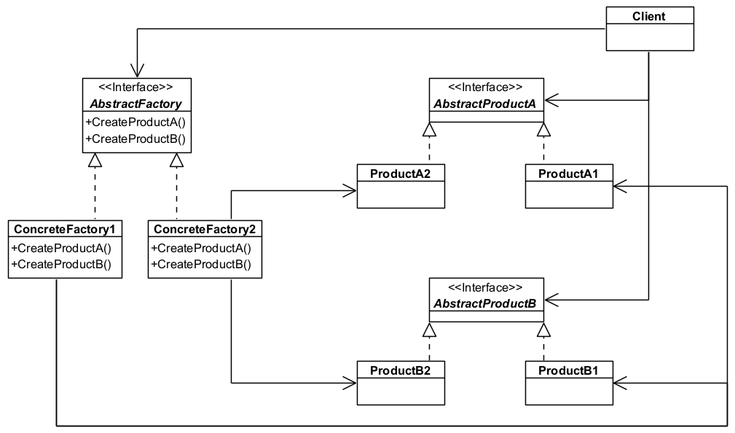
The Abstract Factory Pattern
Notes:
This is the class diagram for the abstract factory pattern. We have an || interface called AbstractFactory that specifies possibly multiple methods to create multiple objects. We then have || ConcreteFactories that implement the AbstractFactory interface that will override these methods to produce specific product objects. Speaking of products, we have || interfaces called AbstractProducts that define operations that the different products need to implement, and of course we will have || ConcreteProduct classes that are concrete implementations of the AbstractProducts. Each ConcreteFactory will create specific ConcreteProducts, so in this case ConcreteFactory1 produces Products A1 and B1, while ConcreteFactory2 produces Products A2 and B2. Finally, we have a || Client class that makes use of an AbstractFactory to create the multiple AbstractProducts as necessary.

Slide 22
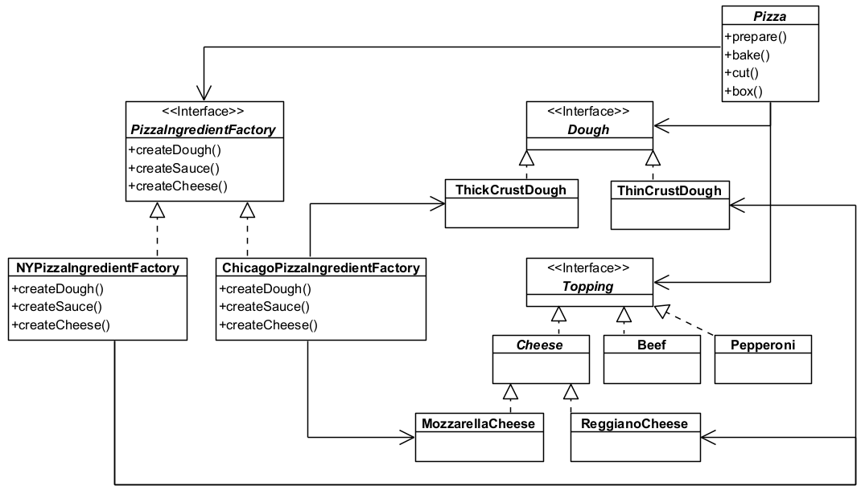
Applying Abstract Factory to PizzaHot
Client
AbstractFactory
AbstractProduct
ConcreteProduct
ConcreteFactories
AbstractProduct
ConcreteProduct
Notes:
And here is how we applied the AbstractFactory design pattern to our PizzaHot scenario. Our || PizzaIngredientFactory interface is our AbstractFactory. It basically specifies that all PizzaIngredientFactories must be able to create its own version of dough, sauce and cheese. We then have || region-specific ingredient factories such as New York and Chicago, at they will each create their own version of these ingredients. For each ingredient type, we have || an interface that acts as a base class, which are the AbstractProducts, such as Dough and Topping. Then for each of these ingredient types, we have || specific implementations of them, which are the ConcreteProducts. We see here that the NYPizzaIngredientFactory will produce ThinCrustDough and ReggianoCheese while the Chicago factory will produce ThickCrustDough and MozarellaCheese. Finally, our || Pizza class is the Client, and depending on the ConcreteFactory that it uses, it will produce different types of pizza using ingredients produced by that factory.

Slide 23
Key Participants
AbstractFactory
Declares an interface for operations that create abstract product objects.
ConcreteFactory
Implements the operations to create concrete product objects.
AbstractProduct
Declares an interface for a type of product object
ConcreteProduct
Defines a product object to be created by the corresponding concrete factory.
Implements the AbstractProduct interface.
Notes:
In summary, the Abstract Factory pattern has 5 key participants.
The || AbstractFactory defines an interface for operations that create abstract product objects, and the || ConcreteFactory implements these operations to create ConcreteProduct objects.
We also have || AbstractProduct interfaces that defines types of products, and the || ConcreteProduct classes will implement the AbstractProduct interface that specifies an actual product object. Each ConcreteFactory will produce a specific ConcreteProduct.

Slide 24
Key Participants (cont.)
Client
Uses only interfaces declared by the AbstractFactory and AbstractProduct classes.
Notes:
And finally, we have the Client that uses the AbstractFactory class to produce AbstractProduct objects. Note that the Client is not aware of any ConcreteFactories or ConcreteProducts, so it is decoupled from those implementations.

Slide 25
What Have We Achieved?
Clients are isolated from concrete classes
Client manipulates instances through abstract interfaces
Creating objects is encapsulated in the factory
Easy to exchange product families
Just replace one factory with another
Promotes consistency among products
Enforces that only one family of products (e.g., a specific regional type of pizza) is used at a time
Notes:
And that’s the Abstract Factory design pattern. What have we achieved? Well, we know that || clients are isolated from concrete classes because they only use abstract interfaces to manipulate instances, and this is possible because we have encapsulated all the object creation logic into separate factory classes. This means that any changes to products is a lot less likely to affect the client code. This also means that if we want to create a new product using a new family of ingredients, we can just || replace the factory with another one, even during run-time. Finally, this design pattern || promotes consistency among products in that each family of ingredients is grouped together, so you can avoid creating things like pizzas having Chicago-style thick crust dough using New York style Reggiano cheese. That would be an abomination which would offend people from two cities at the same time.

Slide 26
Factory Method vs. Abstract Factory
Both are factory methods in charge of creating objects
Factory Method
Uses subclasses that override a factory method
Creates a single object
Abstract Factory
Uses object composition
Creates a family of objects
Notes:
At this point, let me compare the Factory Method design pattern that we learned in the last lesson with the Abstract Factory design pattern we covered here. Both of these are || creational design patterns that are in charge of creating objects, and both define a method to do so, but they use different techniques and have different objectives. If you recall, we used the || Factory Method pattern to define different types of regional stores that override a PizzaStore base class, and each store creates specific types of pizzas. So the Factory Method pattern uses subclassing to create the regional stores, and each store creates a single object. In contrast, the || Abstract Factory pattern uses object composition instead of subclassing by combining different region-specific ingredients together, and it essentially provides the shopping mall for obtaining a family of objects.

Slide 27
Things to Note
ConcreteFactory classes in Abstract Factory are often implemented as Factory Methods
Supporting new kinds of products is difficult
E.g., new regional ingredient
AbstractFactory interface fixes the set of products that can be created
Adding a new product requires extending the interface, so all of its subclasses will be affected
Notes:
In fact, if you look at it carefully, you will see that the ConcreteFactory classes in our Abstract Factory design pattern such as NYPizzaIngredientFactory are actually Factory Methods. This makes sense, because of course you want your ConcreteFactory classes to make concrete products, and that’s what Factory Methods do.
One last thing to note. While the Abstract Factory pattern is really cool in its ability to create a family of objects, it has the downside of || not being able to easily support new kinds of products. For example, if we realize that || onions also vary by region, we would have to add a createOnion() method into our PizzaIngredientFactory interface, which means that all our regional ingredient factory classes will have to be updated to implement this new createOnion() method. || Because the AbstractFactory interface fixes the set of products that can be created, any changes to this interface will necessitate a change in all the ConcreteFactory classes. Now, this is not a deal breaker, but you should try to make sure that the Abstract Factory interface is unlikely to change before using this design pattern.

Slide 28
Summary
The Abstract Factory design pattern
Design Principle
Dependency Inversion Principle
Notes:
We are done with the Abstract Factory design pattern, which allows us to specify an interface for families of products that can be swapped out as a set during run-time as needed. We also covered the Dependency Inversion Principle that tells us that high-level components should not depend on low-level ones, but instead both should depend on abstractions instead.
Silly joke time: What do Homer Simpson and pizza have in common? D-oh! Byee!

